Slide 1
Computational Thinking?
Session-2

Slide 2



Were you able to finish pre-class work for Computational Thinking?
Notes:
🍐 This is a Pear Deck Multiple Choice Slide. Your current options are: A: 👍, B: 👎,
🍐 To edit the type of question or choices, go back to the "Ask Students a Question" in the Pear Deck sidebar.
Hard or Easy
Use this template to do a quick temperature check and self-reflection about the homework. You can learn which students might have struggled with the assignment and therefore might need more attention today.

Slide 3
Table of Contents
Algorithm
Pseudocode
Flowchart

Slide 4
Algorithm
4

Slide 5
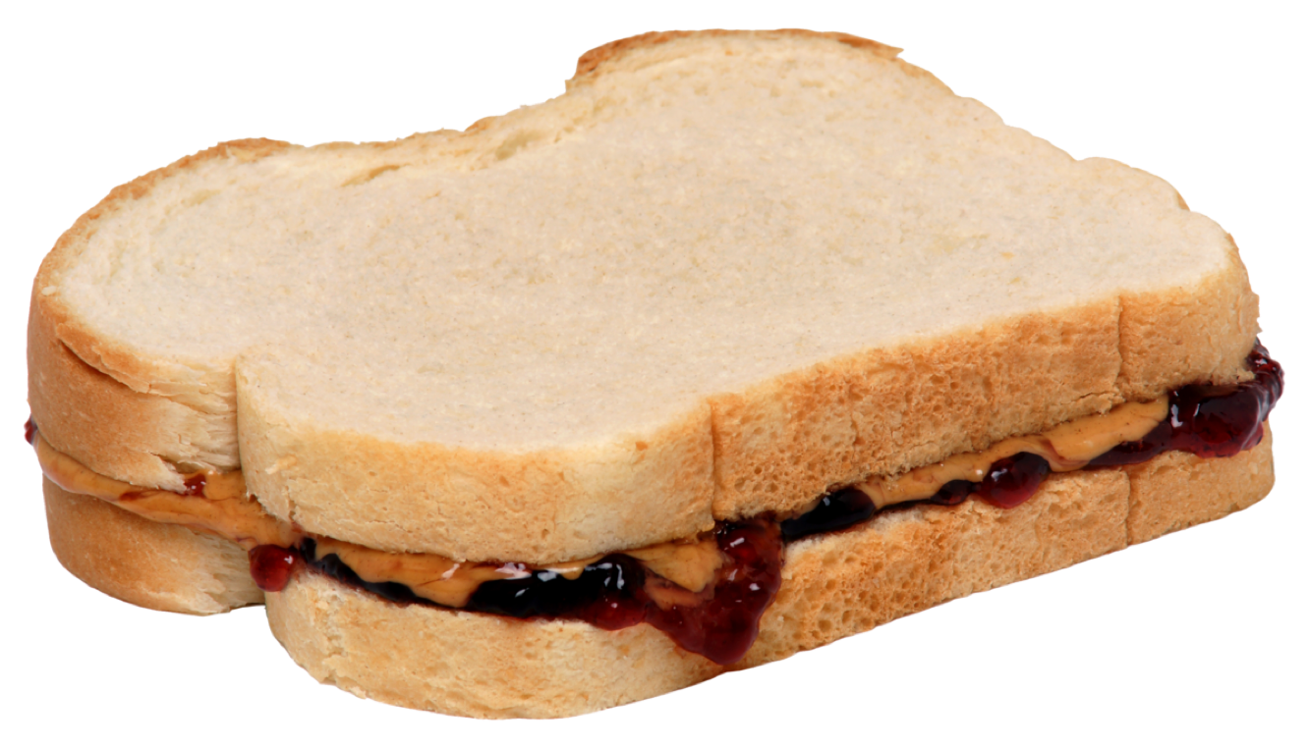
Review
Algorithm
Step by step
Clearly defined
One simple job at a time
Instruct computer what to do

Slide 6
Example: Let’s brew a tea
START
Fetch a tea cup
Add 300 ml of water to the kettle
Boil the water until the kettle switches itself off
Place a new tea bag into the bottom of the cup
Pour 200 ml of boiling water from the kettle, into the cup
Leave the tea bag to stew for 10 seconds
Use a metal spoon to stir the tea bag for 3 seconds
Using the spoon, remove the tea bag from the cup
Dispose of the tea bag
END

Slide 7
Example
This example describes the route
a person will take to leave the house
and
go to work
and
what they will do first when entering the workplace.

Slide 8
Example
Get out of home
Walk to the bus stop
Wait for the bus at the stop in the direction you are going
Get on the bus when your bus arrives
Put your ticket in the ticket box
Walk back when you're close to where you're landing
Press the warning light indicating that you will descend
Get off when the bus stops
Walk to your workplace
Enter through the entrance door of the workplace
Say hello to your coworkers
Wear work clothes
Start your job

Slide 9
Pseudocode
1

Slide 10

Pseudocode
Let’s discuss and try to predict what does pseudocode mean!
Notes:
8 min at the end no debrief

Slide 11
Pseudocode
Pseudocodes are one of two popular ways to represent an algorithm.
Pseudocode is an informal way of representing a computer program or an algorithm.
It looks like a programming language though, it should be written in a programming language for it to be executed. It’s language-agnostic.
Writing pseudocode is basically writing what you want your programm to do in English.
Aims to mimic the general style of a programming language

Slide 12
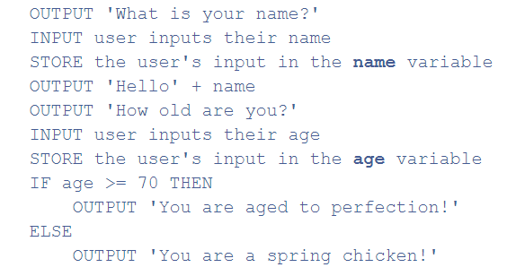
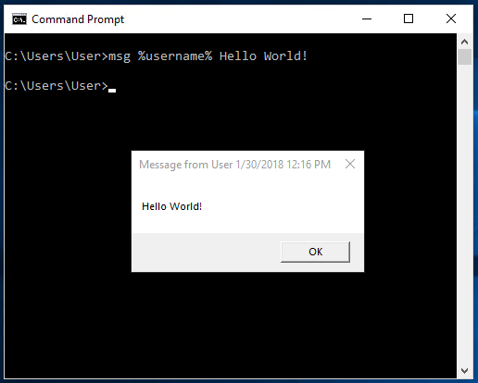
Pseudocode

Slide 13

Pseudocode

Slide 14
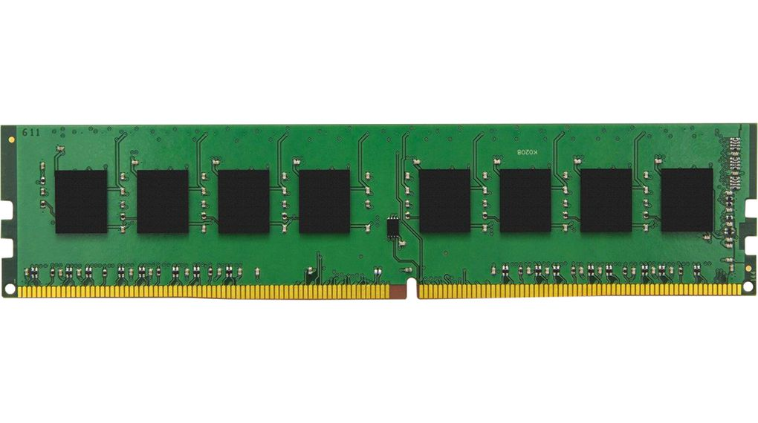
Pseudocode

Slide 15
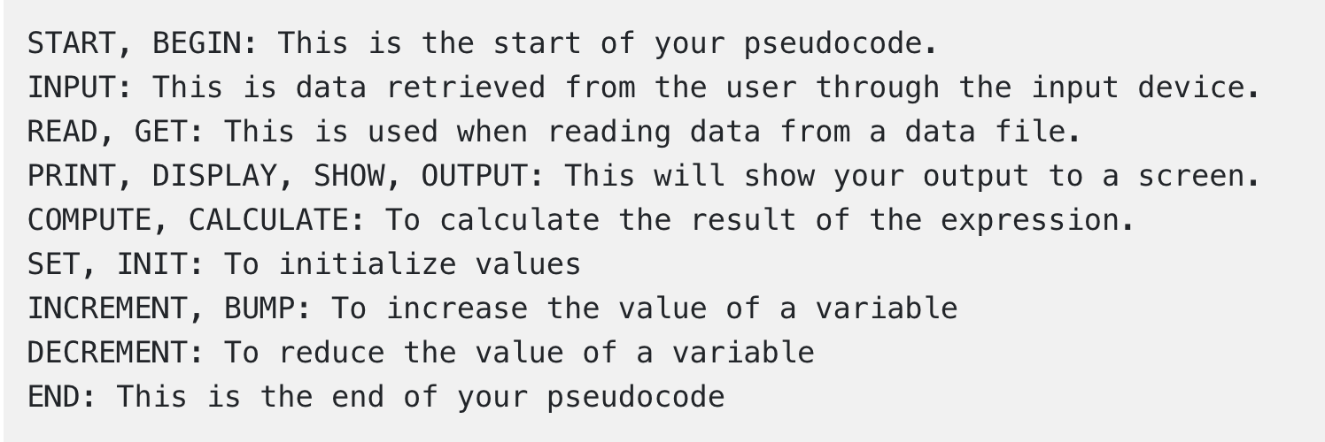
Keyword
There are these keywords that are widely used, you can use your own keywords, but these are the most frequently used amongst other computer programmers and should not be used as variable names.
Notes:
Those keywords might help you on every occasion.

Slide 16
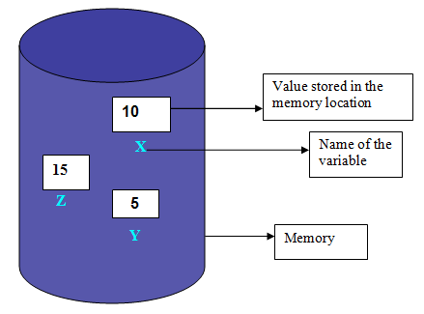
Variable
Variable is a symbolic name associated with a value and whose associated value may be changed.
X = 10
"X" is variable name
10 is variable value
X=10 meaning is X's variable value 10
print x
Notes:
Those keywords might help you on every occasion.

Slide 17
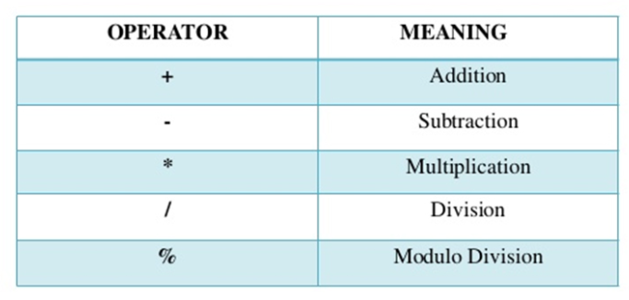
Arithmetic Operators
!
In addition to these, there may be other arithmetic operators specific to the programming language you are using.
Notes:
Those keywords might help you on every occasion.

Slide 18
Example
A pseudocode that outputs the sum of two numbers.
START
PRINT "enter first number"
INPUT number1
PRINT "enter second number"
INPUT number2
sum=number1+number2
PRINT sum
END
Notes:
🍐 This is a Pear Deck Text Slide
🍐 To edit the type of question, go back to the "Ask Students a Question" in the Pear Deck sidebar.

Slide 19
Example
START
INPUT "enter first number",number1 INPUT "enter second number",number2 sum=number1+number2
PRINT sum
END
START
PRINT "enter first number"
INPUT number1
PRINT "enter second number"
INPUT number2
sum=number1+number2
PRINT sum
END
Short
form
START
INPUT number1 ,number2 sum=number1+number2
PRINT sum
END
Shorter form
Notes:
🍐 This is a Pear Deck Text Slide
🍐 To edit the type of question, go back to the "Ask Students a Question" in the Pear Deck sidebar.

Slide 20
Question
Let’s write a pseudocode for calculating Mary’s wage.
Inputs : hours and rate
Output: pay
Notes:
🍐 This is a Pear Deck Text Slide
🍐 To edit the type of question, go back to the "Ask Students a Question" in the Pear Deck sidebar.

Slide 21
Question
Let’s write a pseudocode for calculating Mary’s wage.
Inputs : hours and rate
Output: pay
START
INPUT hours, rate
pay=hours * rate
OUTPUT pay
END
Notes:
🍐 This is a Pear Deck Text Slide
🍐 To edit the type of question, go back to the "Ask Students a Question" in the Pear Deck sidebar.

Slide 22
Decision / Condition
A decision structure is a construct in a computer program that allows the program to make a decision and change its behavior based on that decision.
IF
IF… ELSE…
IF…ELSE IF…ELSE
Notes:
🍐 This is a Pear Deck Text Slide
🍐 To edit the type of question, go back to the "Ask Students a Question" in the Pear Deck sidebar.

Slide 23
IF…
This keyword is used if a certain condition has to be met for the upcoming block to be executed.
If condition
[ Then ] [ statements ]
End If
As you can see we also use indentation in order to declare that “smile” is being executed inside the if statement above it.
each condition has two possibility
True / False
True
False

Slide 24
IF…
For example:
IF you are happy
Then smile
ENDIF

Slide 25
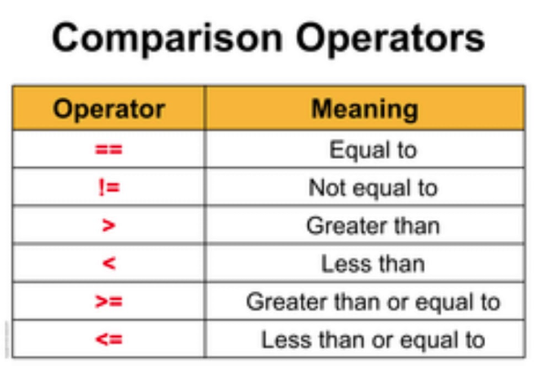
Comparison Operators
!
In addition to these, there may be other arithmetic operators specific to the programming language you are using.
Notes:
Those keywords might help you on every occasion.

Slide 26
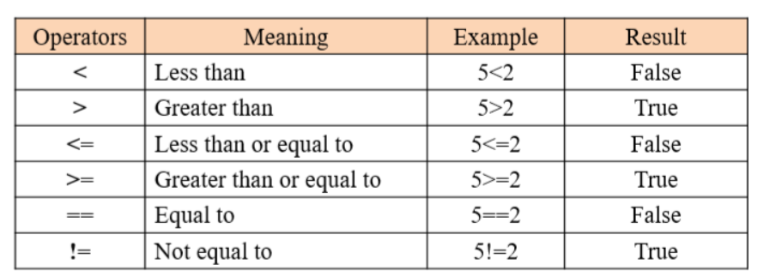
Comparison Operators
Notes:
Those keywords might help you on every occasion.

Slide 27
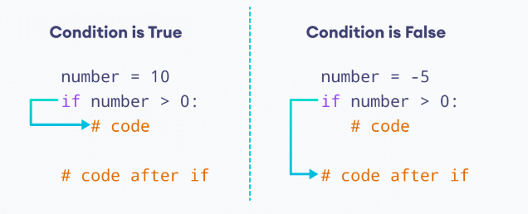
Comparison Operators
Notes:
Those keywords might help you on every occasion.

Slide 28
IF…ELSE…
If condition Then
[ statements ]
Else
[ else statements ]
End If
True
False

Slide 29
IF…ELSE…
IF you are tired
Then rest
ELSE
Keep working
END IF

Slide 30
IF… ELSE IF……. ELSE
If condition
[ Then ] [ statements ]
ElseIf elseifcondition
[ Then ] [ elseifstatements ] ]
ElseIf elseifcondition
.
.
.
Else
[ elsestatements ] ]
End If

Slide 31
IF… ELSE IF… ELSE
IF you are tired
Then rest
ELSE IF you are stressed
Then relax
ELSE
Keep working
END IF

Slide 32
IF… ELSE IF… ELSE
If you are happy
smile
else if you are angry
Calm down
else
try to be happy
ENDIF

Slide 33
Exercise
Write a pseudocode that takes a number as an input and prints true if it is greater than 10 and false otherwise.
Notes:
🍐 This is a Pear Deck Text Slide
🍐 To edit the type of question, go back to the "Ask Students a Question" in the Pear Deck sidebar.

Slide 34
Exercise
INPUT num
if num > 10
print "true"
else
print "false"

Slide 35
Exercise
Let’s write a pseudocode for calculating Mary’s wage.
Inputs : hours and rate
Output: pay
Notes:
🍐 This is a Pear Deck Text Slide
🍐 To edit the type of question, go back to the "Ask Students a Question" in the Pear Deck sidebar.

Slide 36
Exercise
START
INPUT hours,rate
IF hours < 40
pay=hours * 40
ELSE
pay =40 * rate + (hours - 40) * rate * 1.5
PRINT pay
END

Slide 37
Exercise
Takes a number and show is the number positive, negative or neutral?
Notes:
🍐 This is a Pear Deck Text Slide
🍐 To edit the type of question, go back to the "Ask Students a Question" in the Pear Deck sidebar.

Slide 38
Exercise
START
Input number
IF number>0
print ‘positive’
ELSE IF number<0
print ‘negative’
ELSE
print ‘notr’
END

Slide 39
Exercise
Find the largest of the 3 entered numbers.
Notes:
🍐 This is a Pear Deck Text Slide
🍐 To edit the type of question, go back to the "Ask Students a Question" in the Pear Deck sidebar.

Slide 40
Exercise
START
INPUT a,b,c
big=a
IF b>big
big=b
IF c>big
big=c
print big
END

Slide 41
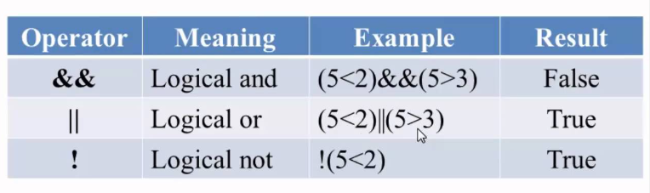
Logical Operators
Notes:
Those keywords might help you on every occasion.

Slide 42
Exercise
Find out whether the student is successful or unsuccessful according to the grade entered.
Notes:
🍐 This is a Pear Deck Text Slide
🍐 To edit the type of question, go back to the "Ask Students a Question" in the Pear Deck sidebar.

Slide 43
Exercise
START
INPUT “enter student grade”, grade
IF grade >=0 and grade<50
print “successful”
else if grade >=50 and grade <=100
print “unsuccessful”
else
print “incorrect entry”
End

Slide 44
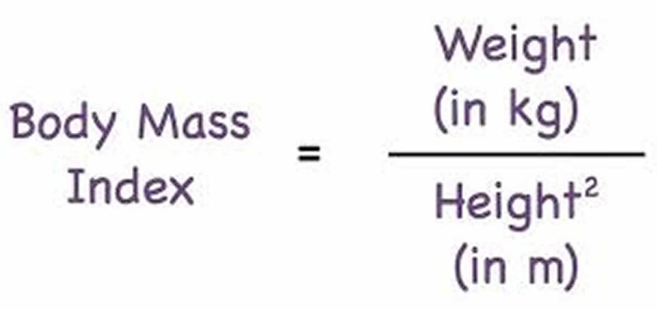
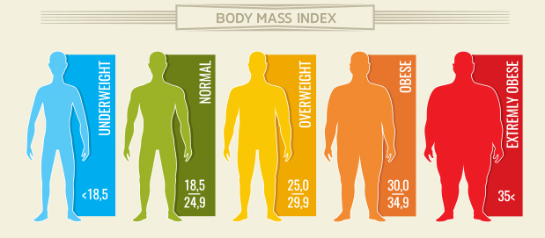
Assignment
Write a pseudocode that finds the classification of body mass index by taking the person's height and weight values.

Slide 45
Assignment
Calculate the shipping fee according to the information given in the table
distince | price multiplier by distance
0-500 | 50
500-1000 | 100
1000+ | 500

Slide 46
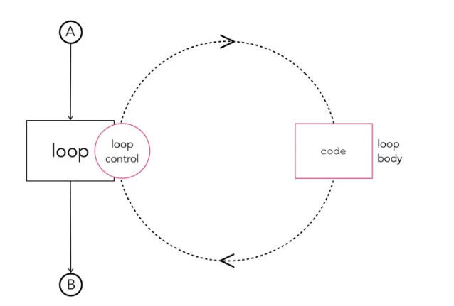
LOOPS
A loop is a sequence of instruction s that is continually repeated until a certain condition is reached.
Notes:
Those keywords might help you on every occasion.

Slide 47
FOR structure
For loop runs for each element inside a group.
For example:
FOR every day of the week
Count;
ENDFOR

Slide 48
FOR structure
For loop runs for each element inside a group. For example:
For every 25 minutes of study
Earn one Pomodoro;
endfor
Pomodoro = Pomodoro +1

Slide 49

Let’s wash the dishes
Let’s wash the dishes. Think that we have all the tools etc.

Slide 50
Let’s wash the dishes
gather the dirty dishes
if you have a dishwasher around you
put the dirty dishes inside the dishwasher
set the settings of the dishwasher
while the time set is not over
wait
else
while dishes are not clean
take one of the dishes
wash it with your hand
dry it and put it aside

Slide 51
WHILE Structure
While is similar to the for loop, differently it runs the loop until the condition provided is unsatisfied.
Example:
Apples = 5
Oranges = 10
While apples < oranges
increase apples;
endwhile

Slide 52

THANKS!
Any questions?

